Slide 1
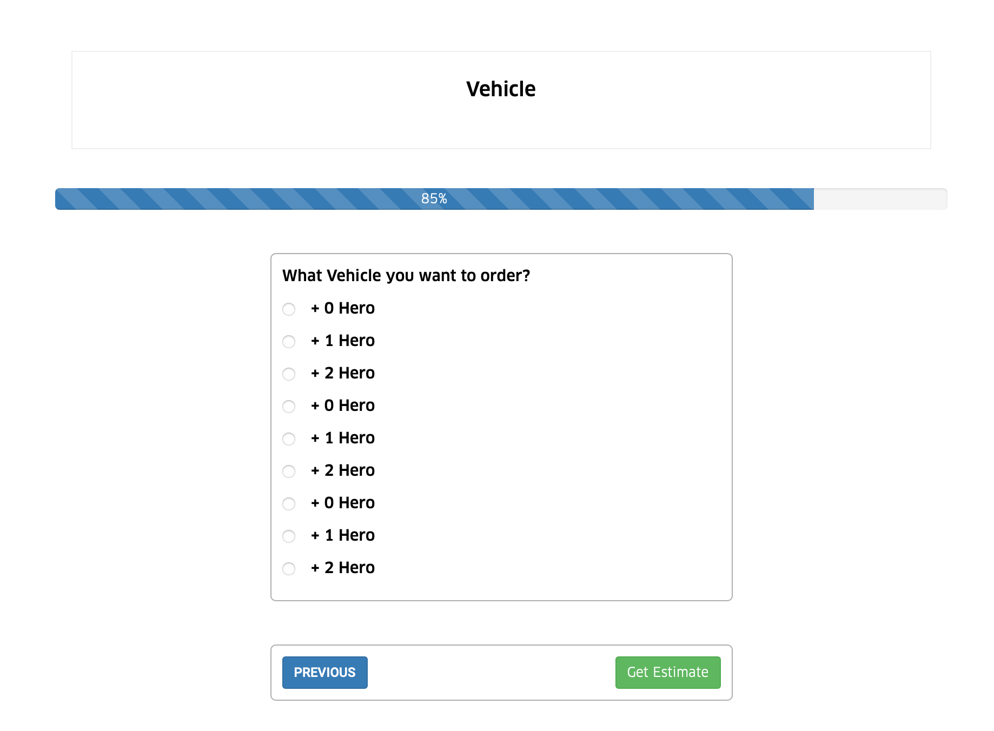


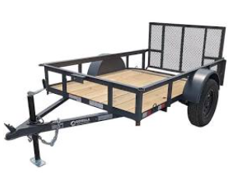
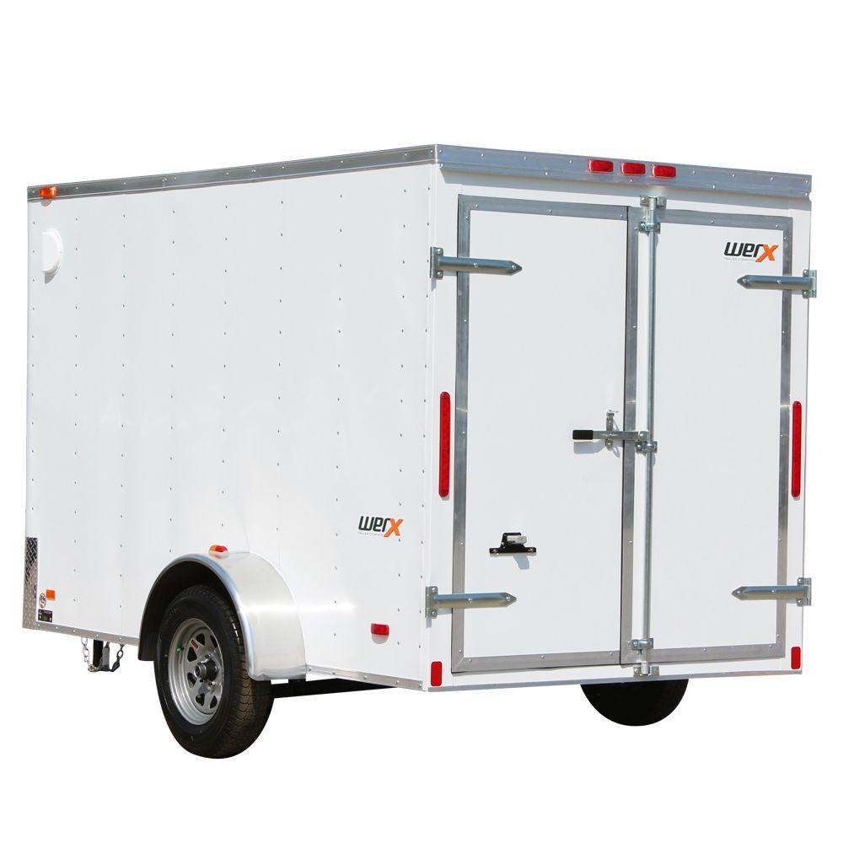
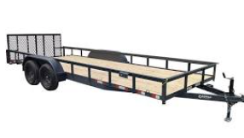
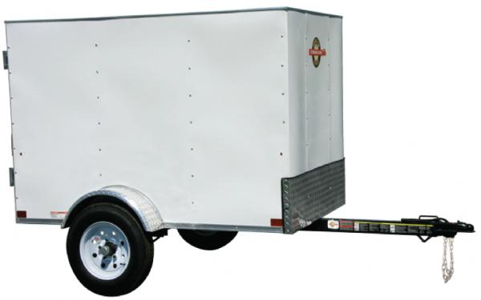
Vehicle Only
We do not need this question about number of hero because it’s Vehicle only.
After item description, add button “Get Estimate”
If people click Get Estimate button, it should show 3 Estimates of 3 type of vehicles: Pickup Truck, Van/Trailer, XL Van/XL Trailer. (see below). Prices just show the total Price, no need details.
Vehicle Only
Pickup Truck
Cargo Footage 4 ft x 6 ft
Van/Trailer
Cargo Footage 4 ft x 8 ft
XL Van/XL Trailer
Cargo Footage 5 ft x 10 ft
$35
$48
$58
When people click “Select”. → please see next slide
Select
Select
Select
Warning! If you choose wrong size of vehicle, you can only haul smaller number of items. Please compare vehicle footage with your items footage.

Slide 2

Extras prices should be adjustable inside admin panel
Extras:
1 Hero – 30 mins ($30)
2 Heroes – 30 mins ($50)
Hardwood floor ($30)
Dropoff at specific room in the house ($15)
Involving stairs ($30)
Van/Trailer
Cargo Footage 4 ft x 8 ft
$48 → $78 (price will change if customer choose extra and enter promo code)
Promo code
Apply
Book
Start Over
After customer press Book, request should go to all Van/Trailer Drivers within 30 mile radius. Fastest driver who accepts the request will get it
Warning! By default, our service is CURBSIDE Dropoff. If you require special requests, please purchase our EXTRAS.

